Slide 1

Translating synthetic natural language to database queries with a polyglot deep learning framework​
Adrián Bazaga, Nupur Gunwant & Gos Micklem
2021

Slide 2
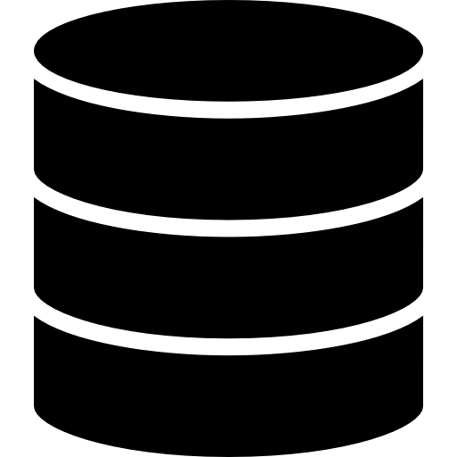
Database
DataBase Management System (DBMS)
SQL
MySQL
Cypher
Neo4j

Slide 3
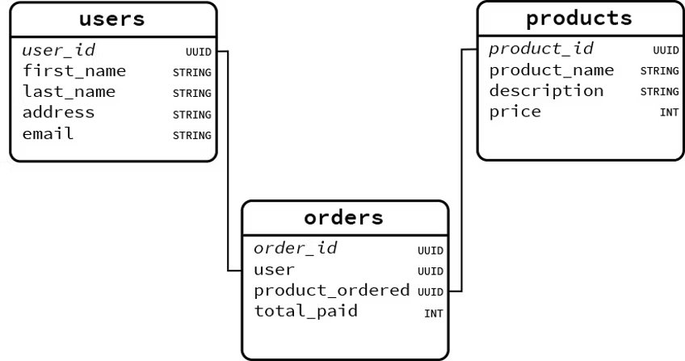
Relational Database scheme

Slide 4
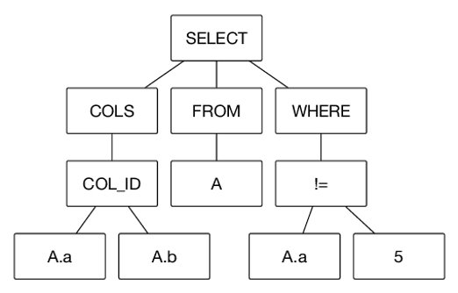
SQL grammar

Slide 5
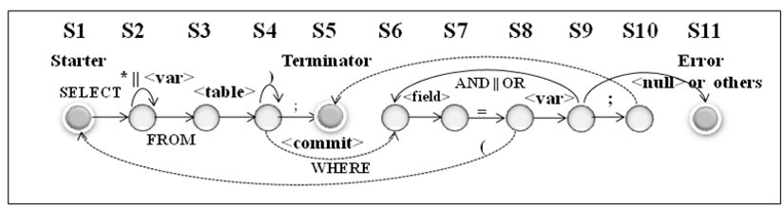
MySQL automata

Slide 6
How to get the information
Get the first name of the users that bought product “umbrella”
SELECT first_name
FROM Users
INNER JOIN Orders ON user_id = user
INNER JOIN Products ON product_ordered = product_id
WHERE product_name = 'umbrella’;

Slide 7
In order to query from a dataset you need to know:
Database manager format​
Keywords​
Grammar ​
Logic​
Scheme of the database
…Or the scheme of the database and can ask ChatGPT…

Slide 8
Use NLM to change from text
Seq2SQL (2017)
Based on tokens
SQLNet (2017)
sketch-based scheme; dependency graph
Neural Enquirer (2016)
ranked list of possible answers
synthetic question-table-answer triples
DBPal (2019)
synthesizes NL queries and statements from a database schema
data augmentation
SQL
Single table
Specify Table
User still requires to know the database schema
Notes:
augmentation by means of paraphrasing to make the model more robust to linguistic variation, and devise a manually crafted dataset of 300 queries to assess the robustness of the model, where the same NL query is written with multiple linguistic variants.

Slide 9
Datasets for training
WikiSQL, comprising 80,654 manually annotated example questions, and their equivalent SQL queries and results across 24,241 tables from Wikipedia (Seq2SQL )
synthetic dataset containing 100,000 query-table-answer triples (Neural Enquirer)

Slide 10
Polyglot
Polyglotter handle queries for a variety of database engines
The user does not need to know the scheme of the database nor the DBMS

Slide 11
Training
Get the database schema
Graph representation of database Scheme
Synthesizing training data using random query generation
Train neural sequence-to-sequence model with an attention mechanism
Evaluation of queries predicted from natural language

Slide 12
Graph representation of database Scheme
Abstract representation for user queries in the form of a graph
a class with any one of its attributes
a class with any one of its attributes and a constraint on that attribute
Classes
Type of entities that the database stores (tables for SQL)
Attributes
properties of these entities (column names)
Constraints
Where
Conditions of the query

Slide 13
Graph representation of database Scheme
Node represents a class
Edges class-class relationship
Nodes are enriched with the attributes that it contains

Slide 14
Graph representation of database Scheme
Node represents a class
Edges class-class relationship
Nodes are enriched with the attributes that it contains
user_id
first_name
last_name
address
email
User
Product
Order
product_id
product_name
description
price
order_id
user
product_ordered
total_paid

Slide 15
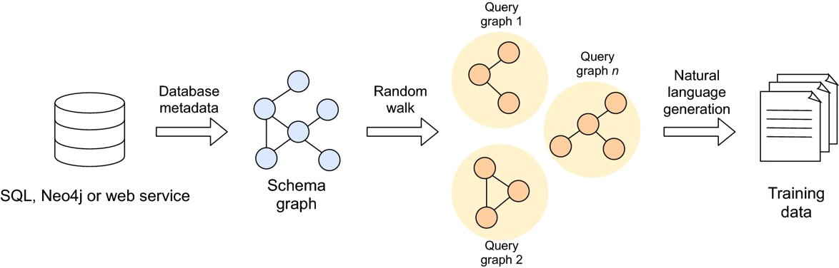
Synthesizing training data using random query generation

Slide 16
Synthesizing training data using random query generation
Random walk is chosen randomly following a uniform distribution over classes
Attribute and constraint choice probabilities
The constraint logic is picked randomly over a distribution of possible logical operators.
They capped to a maximum of 5 classes per query.

Slide 17
Creating the training corpus
Each walk is translated into an equivalent query in English using FastText
Added into the Training dataset with their target pairs and triples.

Slide 18
FastText word embedding
Semantics of 1 million words extracted from a 2017 version of Wikipedia.
vocabulary is placed in the context of more general English
when used in production, this word embedding mediates between the diversity present in user queries and the Transformer model.
capture some of the diversity of expression that an English

Slide 19
Diversity of expression
Native speakers would naturally choose between a variety of ways of doing
Wording
Prioritization
Synonyms
They randomly chooses one of six different styles of sentence, where each variation alters the order in which the different types of element (class, attribute, constraint) are dealt with.

Slide 20
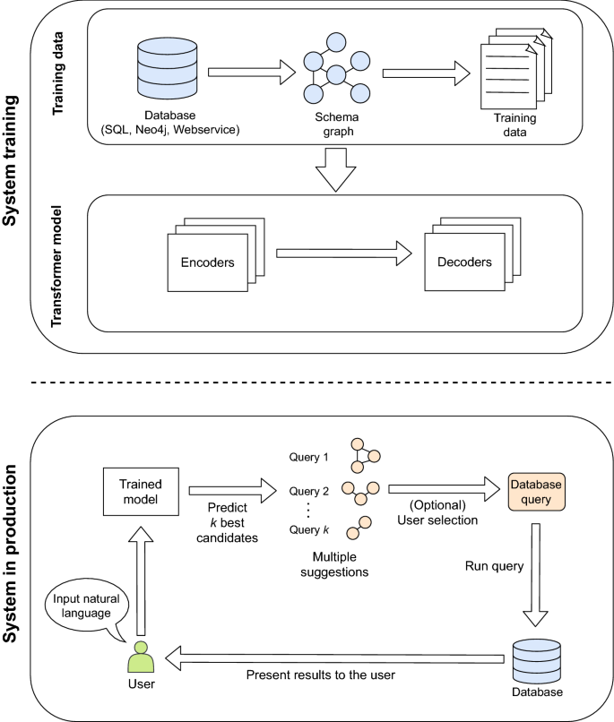
Development of a neural sequence-to-sequence model with an attention mechanism
deep learning-based sequence-to-sequence model
Transformer architecture
multi-headed attention of 8 layers
6 layers in each of the encoder and decoder
512 dimensions for input and output
Initialize weights with Glorot.
Adam as the optimizer
Learning rate to 2.
Weight decay Noam.

Slide 21
Training
MySQL, Neo4j and web services/APIs.
HumanMine, an open-source biological data warehouse for Homo sapiens data.

Slide 22
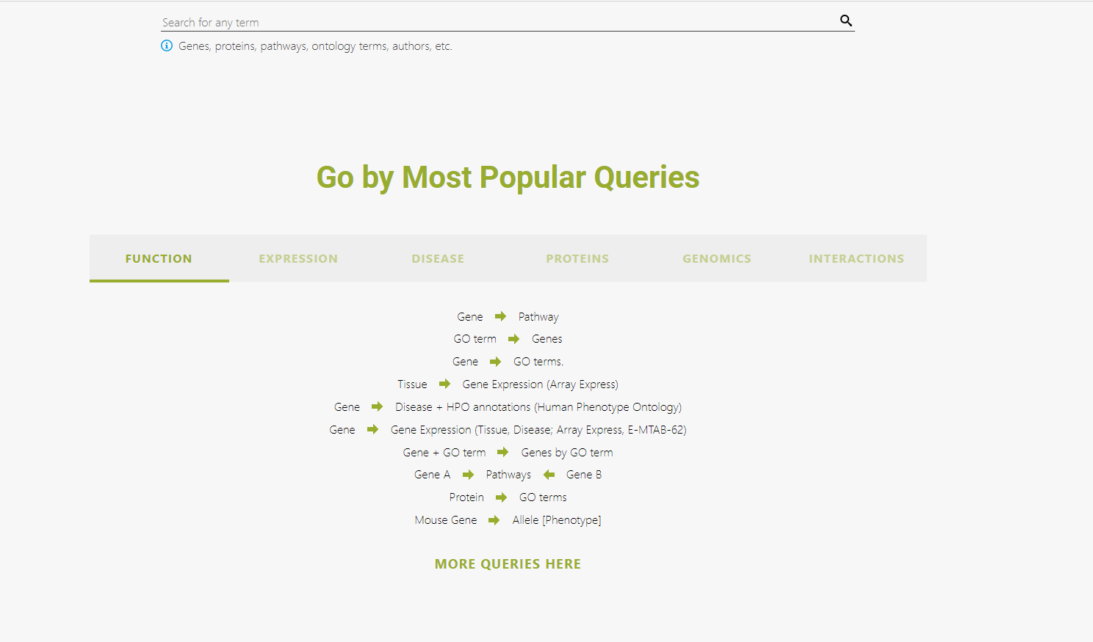
HumanMine

Slide 23
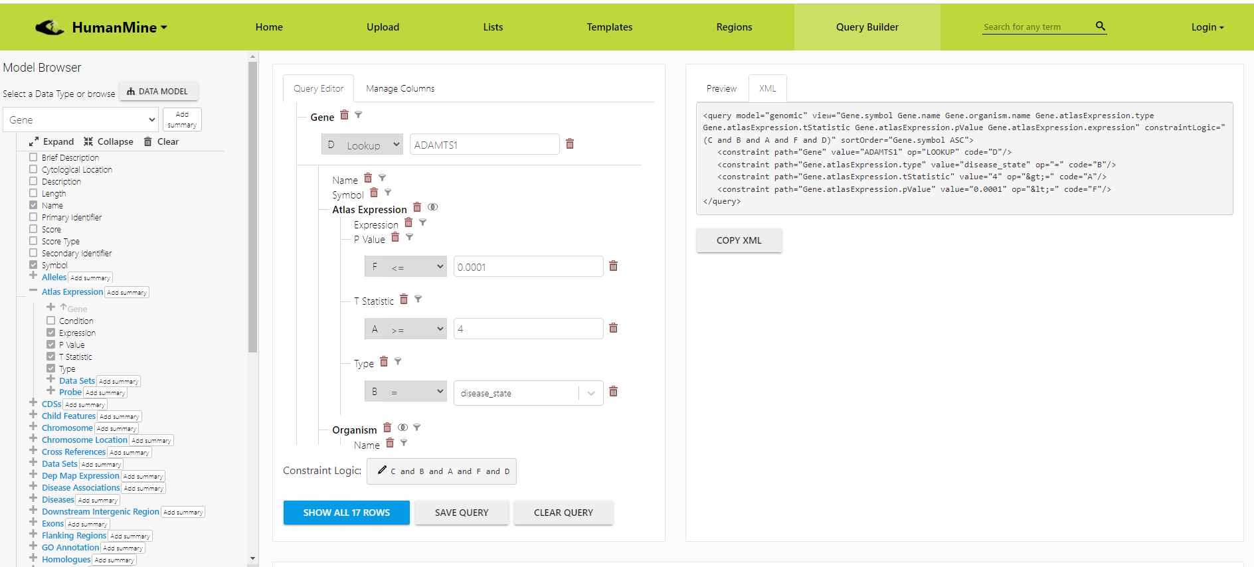
Assisted REST query

Slide 25
Evaluation of queries predicted from natural language
report the global accuracy by comparing the predicted query graphs against the known true query graph.
Global accuracy:
the fraction of total testing set for which the predicted query graphs match exactly the ground truth for all the pairs and triples that comprise the query (i.e. predicting accurately all the attributes, classes and constraints).

Slide 26
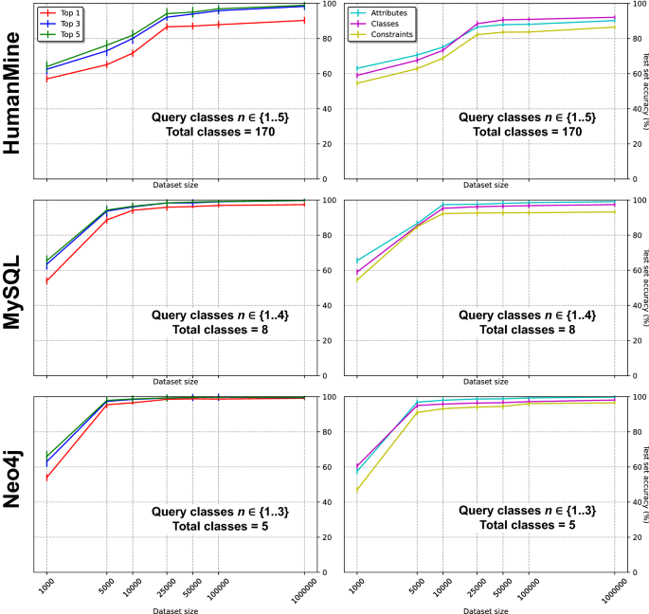
Evaluation of queries predicted from natural language
Predicting the attributes was more difficult than predicting the classes
HumanMine has 103 unique attributes
MySQL 59
Neo4j 42

Slide 27
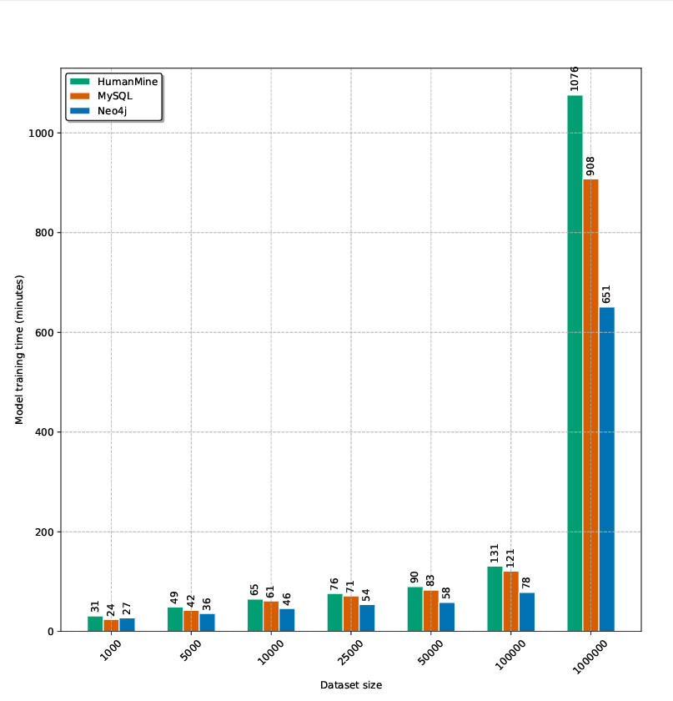
Training time
for the most complex database (HumanMine) and the largest dataset size (N = 1,000,000)
17 hours
A single low-end workstation with a NVIDIA GeForce RTX 2070 GPU

Slide 28
To conclude, Polyglotter…
support questions over multiple tables in a single query
synthetic data for training from the data models of each of the supported database engines
simple and data-less way to build natural language interfaces supporting multi-table queries
supports multiple database engines
can be extended to support other database systems.

Slide 29
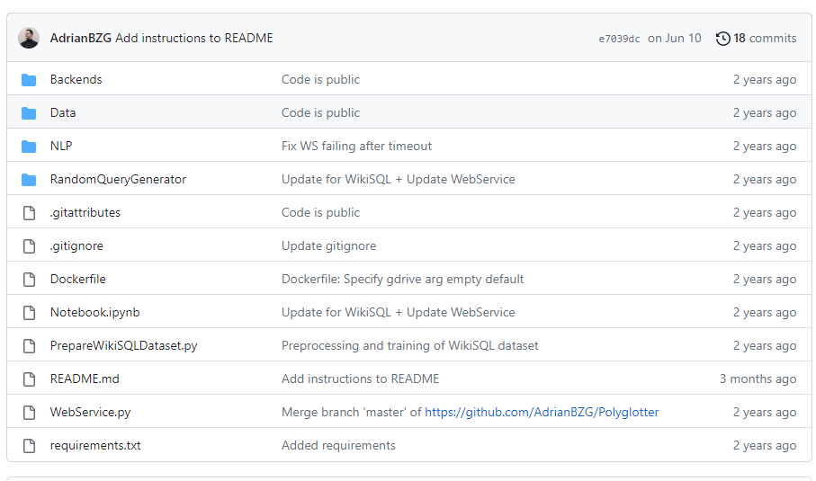
How to use it
https://github.com/AdrianBZG/Polyglotter
Scripts for:
Create Schema
MySQLGetDBSchema.py
Generating the dataset of question-query pairs
GenerateRandomQueries.py
Train the model
TrainModels.py

Slide 30
How to use it
Documentation is not great but you can work through the code
Changes to the code are needed in some parts (like setting the SQL configuration or specify names)
Manual creation of folders is needed
Dockerfile container is included
Jupyter Notebook

